Slide 1
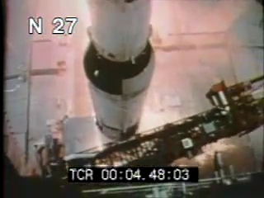
Docker @ EMC
Exploding rockets, DevOps, and Containers
Rich Barlow – Advisory SE, Partner Principal, vSpecialist

Slide 2
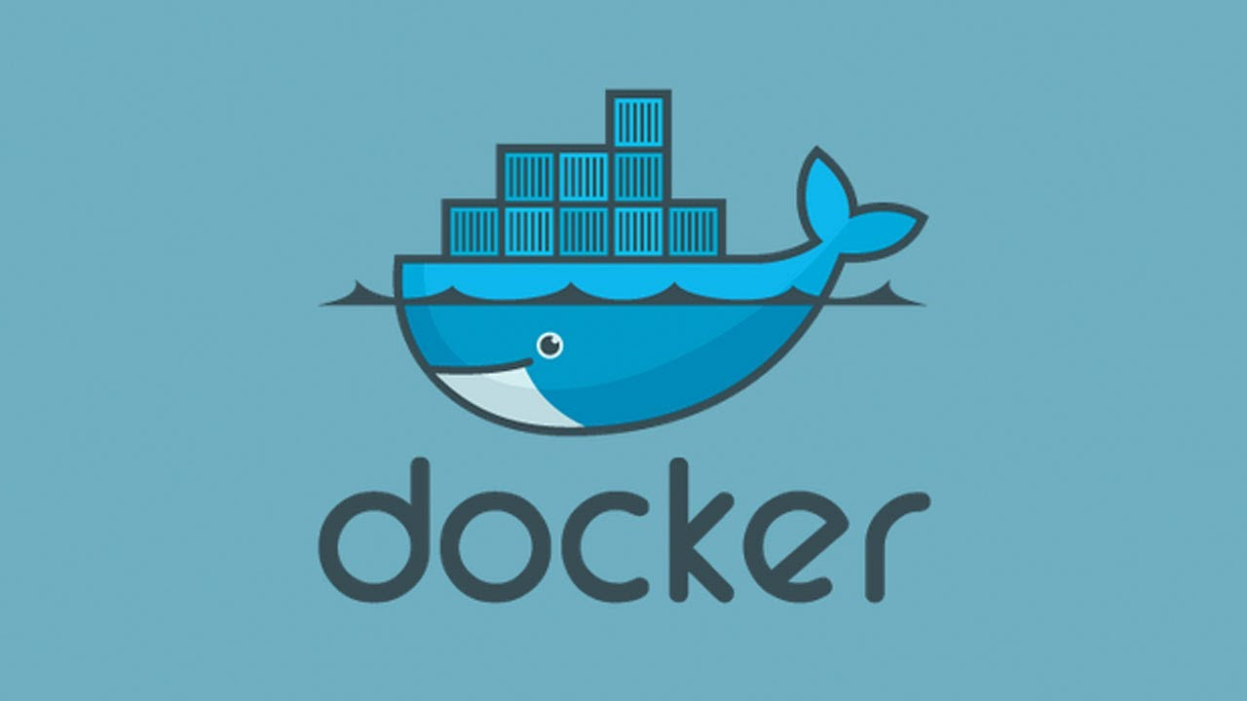
What is Docker?
Docker is an open platform for developers and sysadmins to build, ship, and run distributed applications that was launched in March of 2013.

Slide 3
In just 20 months . .
2.75M+
downloads
250+
meetups
9K+
pull requests
12K+
stars
460+
contributors
90+
cities
6.7K+
projects
30K+
dockerized
8.5K+ commits
30+
countries

Slide 4


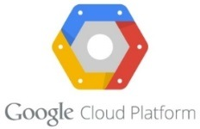






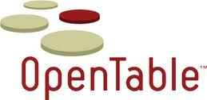






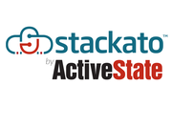

A small subset of users . . .
*A small subset of the 100s who are using and/or writing about us
Thanks to those above for talking about their experiences at DockerCon

Slide 5
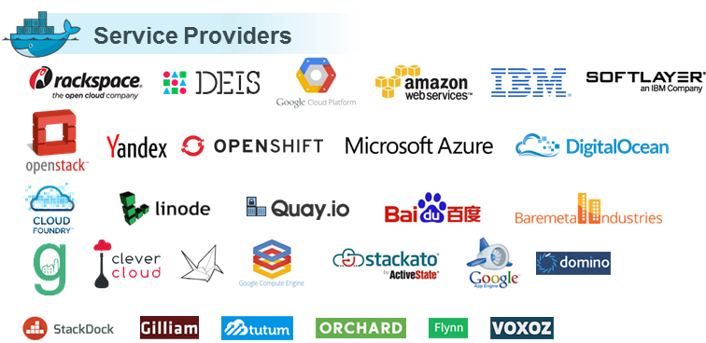
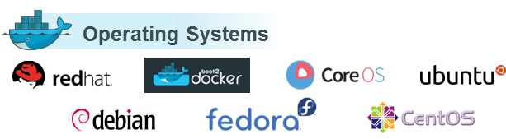
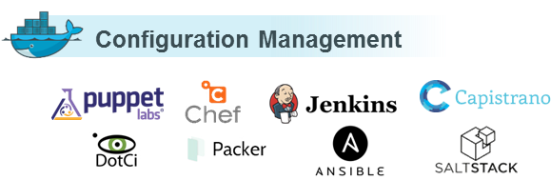
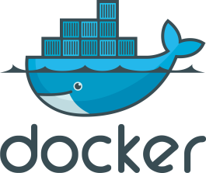
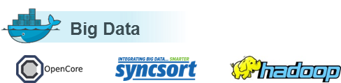
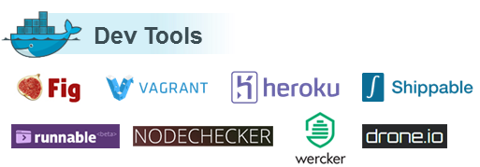
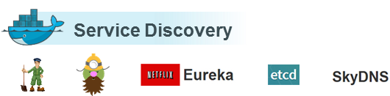
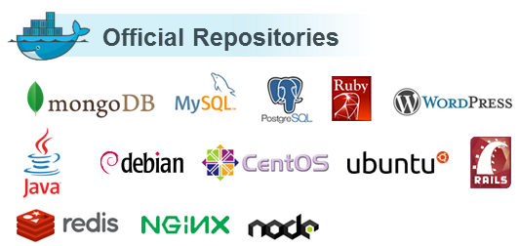
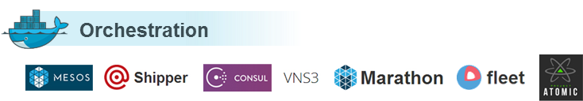
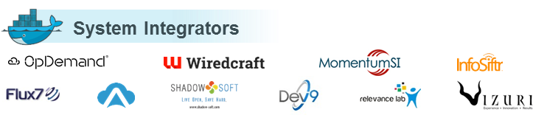
And a thriving ecosystem . . .

Slide 6


Google is “all in” for containers
Launches 2 billion (with a B) containers a week
That means that every second
of every hour
of every day
Google launches 3,300 containers
Almost 1,000,000 containers launched since I started talking

Slide 7
A little history . . .

Slide 8
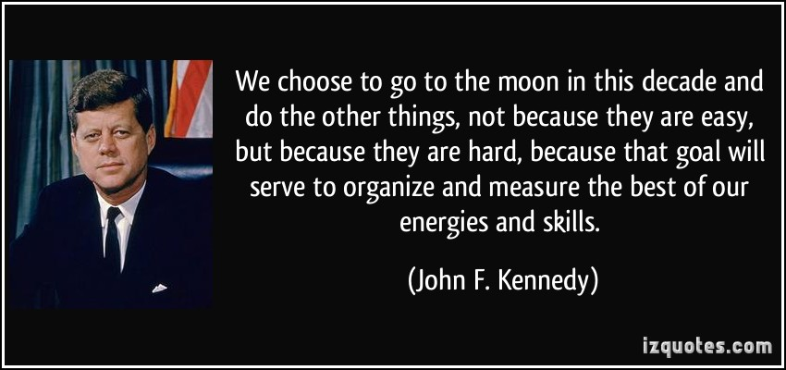

Slide 9
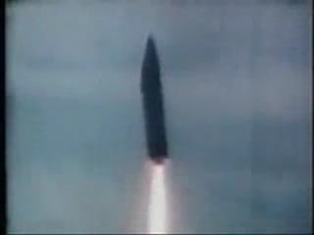
“In 1963 . . . Atlas rockets were blowing up everyday at Cape Canaveral. It looked like a quick way to have a short career”
- Jim Lovell, Apollo 13

Slide 10
5 years later . . .

Slide 11
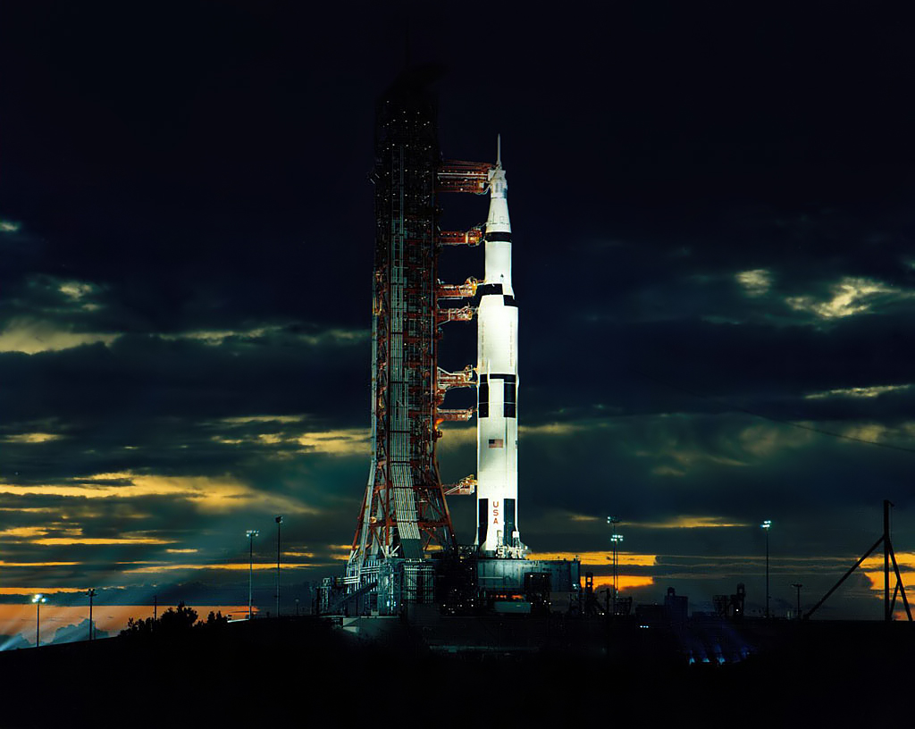
The mighty Saturn V
7.5 Million pounds of thrust
363ft tall – 33ft in diameter
2 million liters of fuel just in first stage
3 million separate parts
Could lift 260,000 pounds to LEO or 100,000 to TLI
5.6 million pounds with fuel
Accelerated payload to 24,500mph for TLI
Most complex machine ever until Space Shuttle
8.72 Billion adjusted dollars per vehicle
Success Rate: 100%

Slide 12
Neil Armstrong said "even at 99.999% perfect (the legendary five 9's strived for in quality control) there would have been thousands of failures. But there were not. There were not even hundreds of failures, there were a few tens of failures on each flight. That meant the vehicles were essentially perfectly assembled."

Slide 13
What happened between 1963 and 1968 to make such an incredible impact?

Slide 14
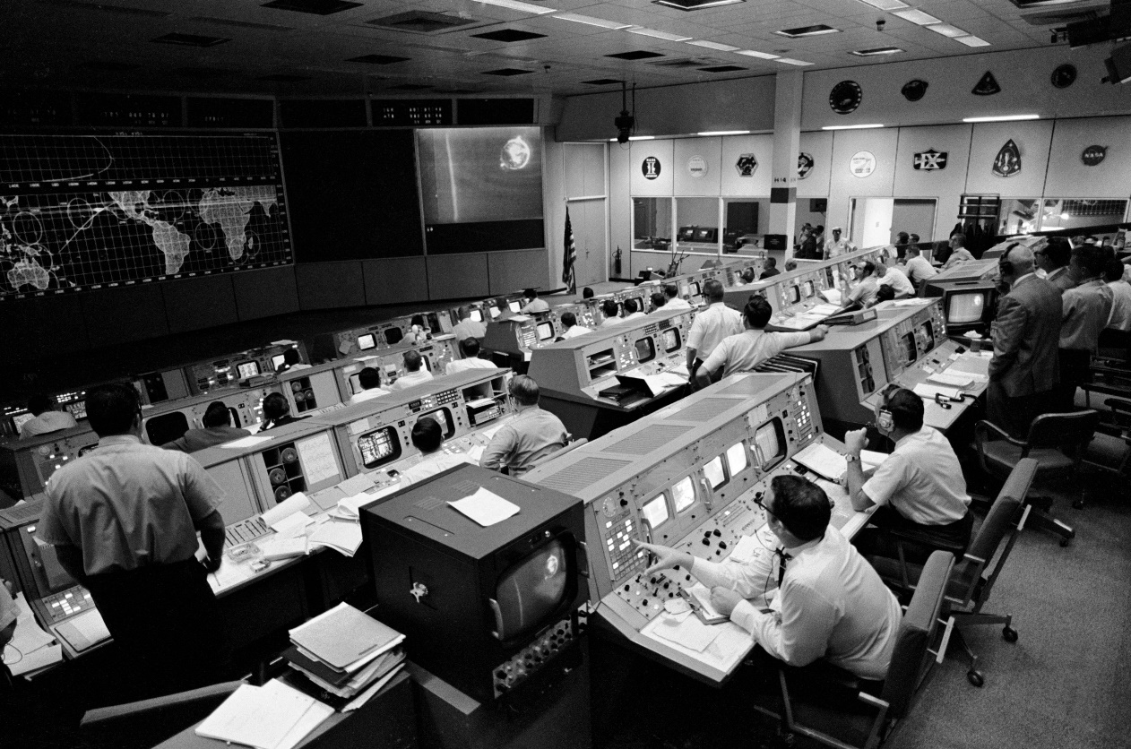
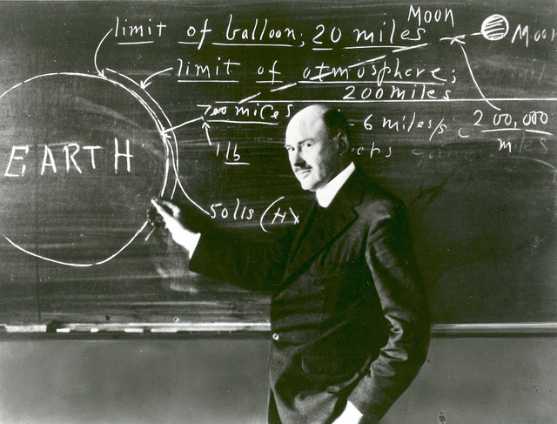
OPERATIONS
DEVELOPMENT

Slide 15

No more monolithic builds
Each subassembly was designed to a spec
Rigorous testing of all components together
Use “off the shelf” technology as often as possible
Simulation, simulation, simulation
Open (for 1960’s) standards
Development and Operations merged into Mission Control
Many modern DevOps ideas were pioneered by NASA

Slide 16
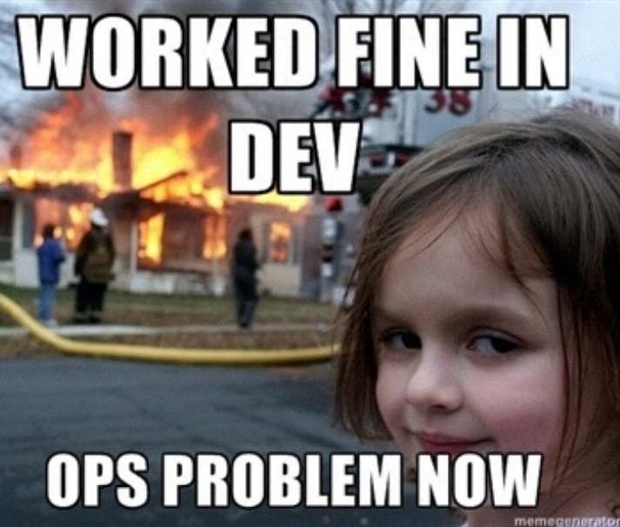
DevOps is hard

Slide 17
Typical development cycle
From an Ops guys point of view
Dev gets code
Something breaks
Dev builds on “dev”server
Ops deploys code
Success!
Code hand off to Ops

Slide 18
Where does Docker fit?
Docker is an open-source engine to easily create lightweight, portable, self-sufficient containers from an application. The same container that a developer builds and tests on a laptop can run at scale, in production, on VMs, OpenStack, Vmware, public clouds, and more
Let’s look at Docker!

Slide 19
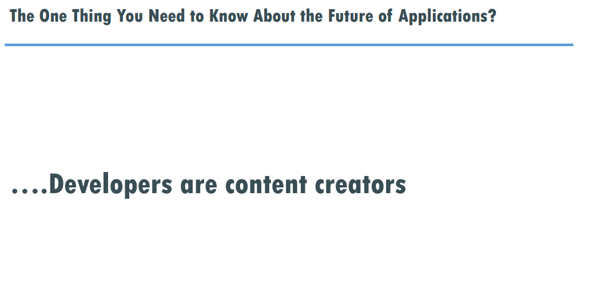

Slide 20
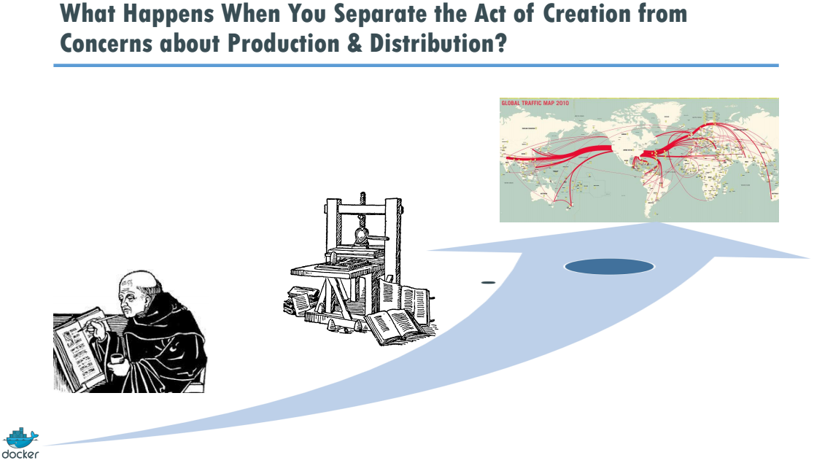

Slide 21
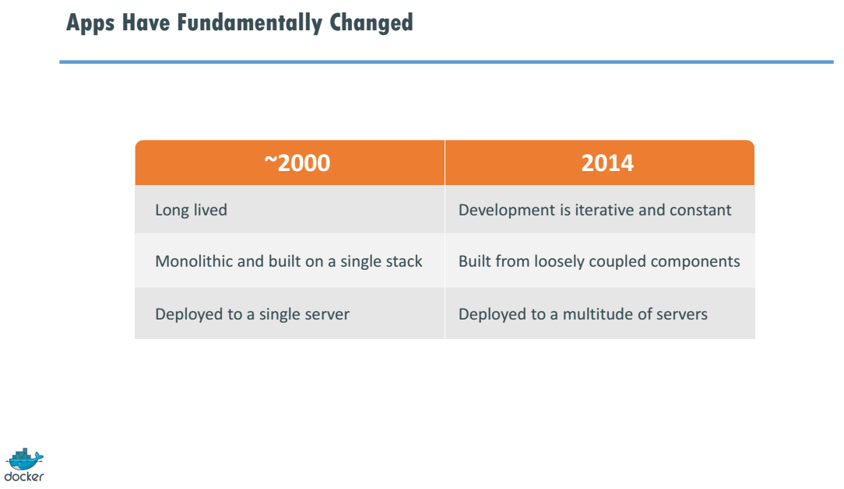

Slide 22
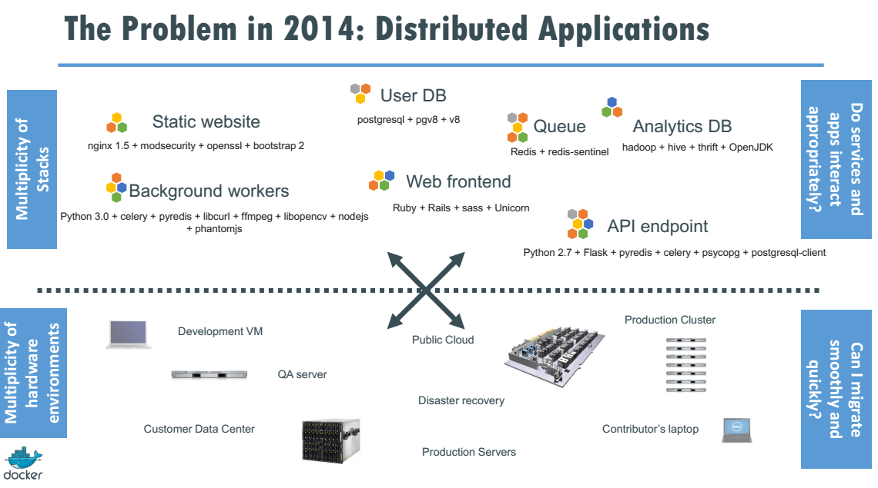

Slide 23
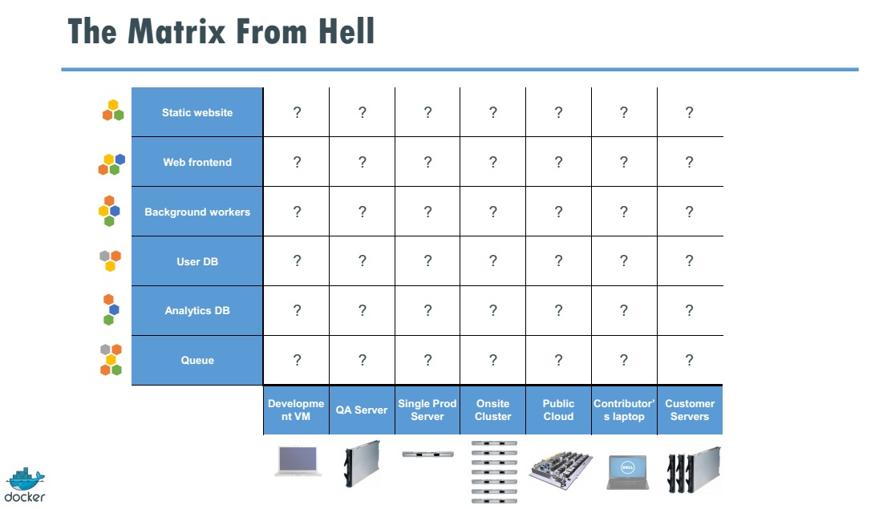

Slide 24
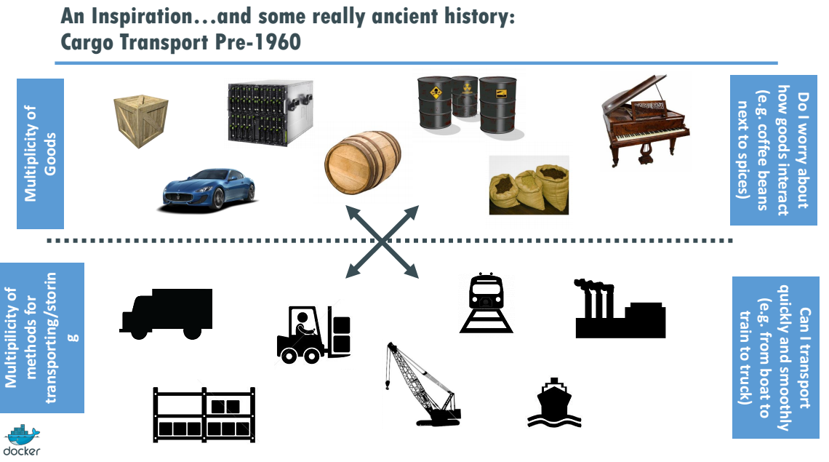

Slide 25
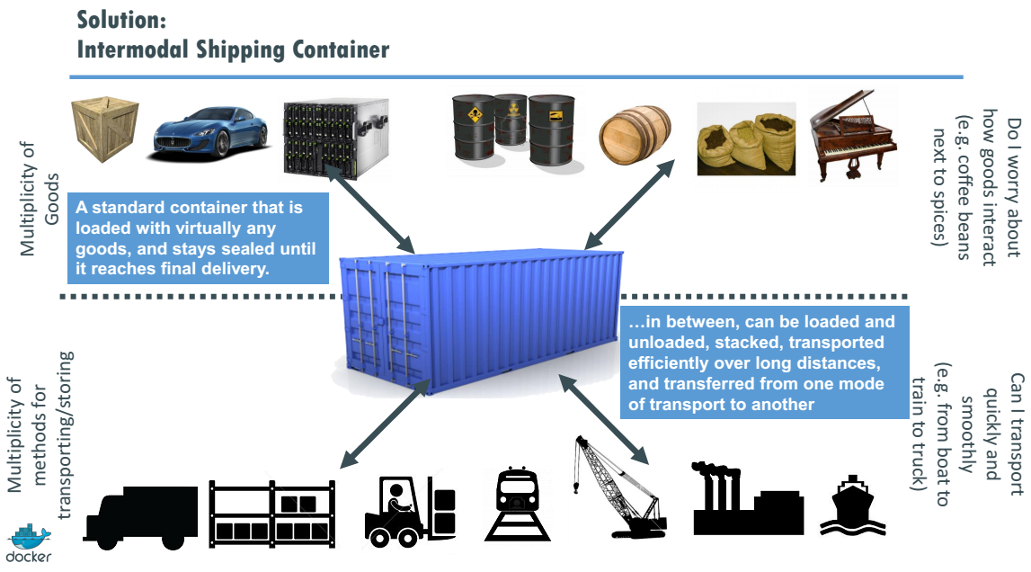

Slide 26
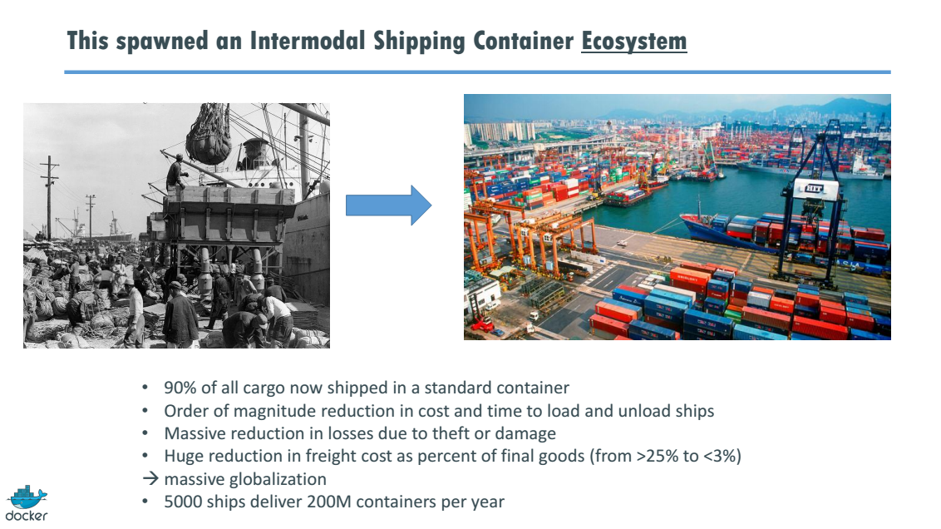

Slide 27
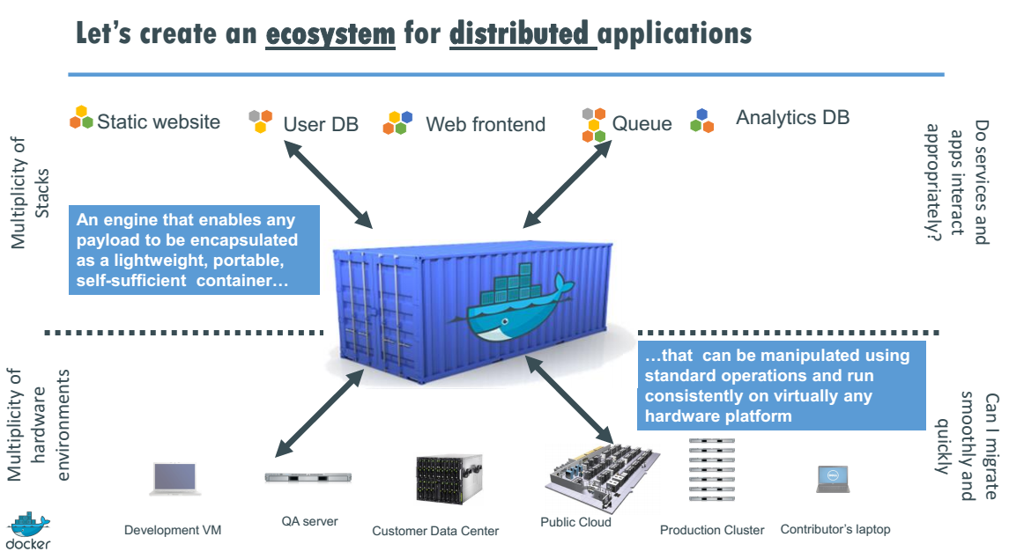

Slide 28
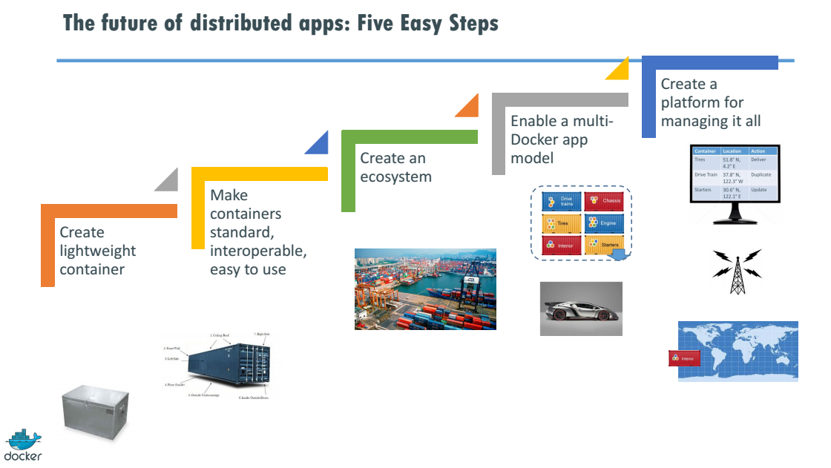

Slide 29
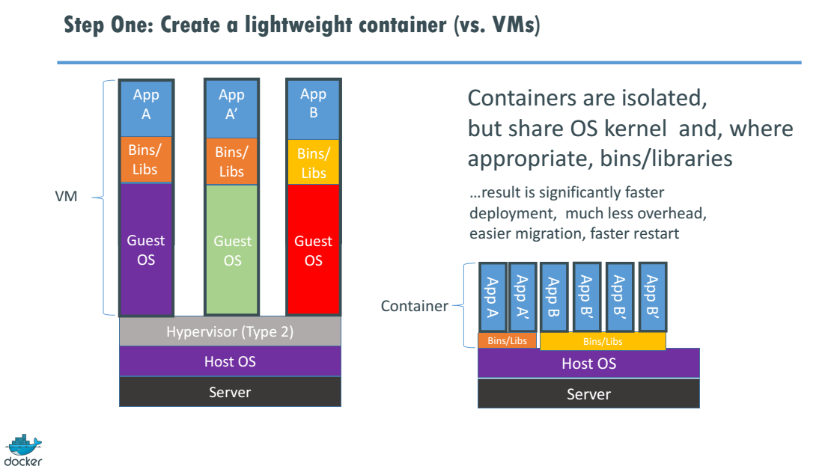

Slide 30
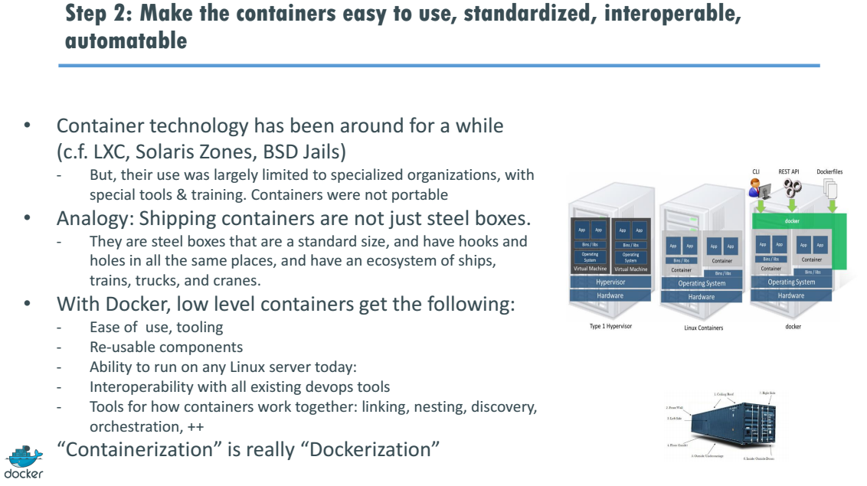

Slide 31
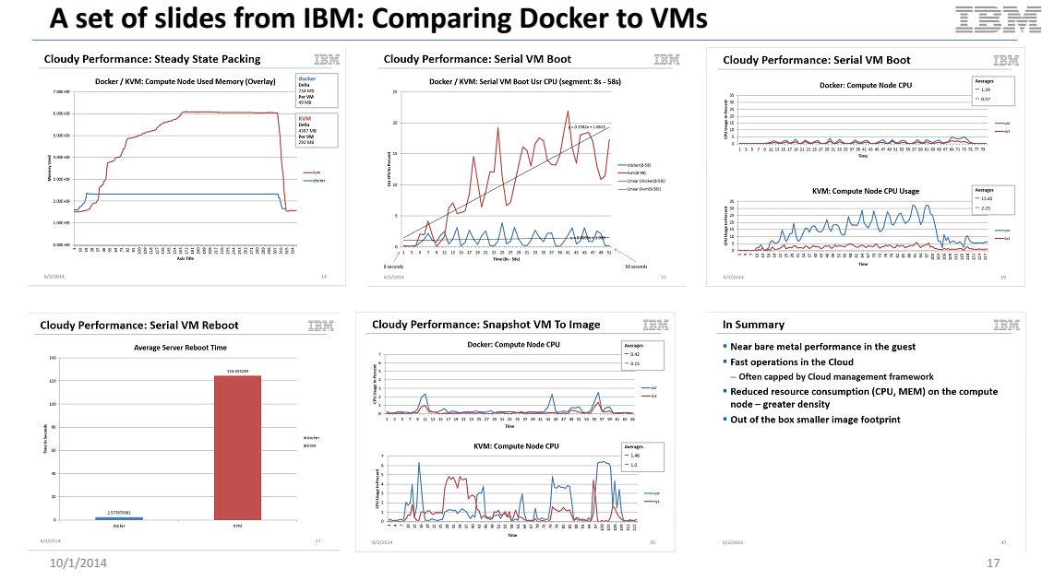

Slide 32
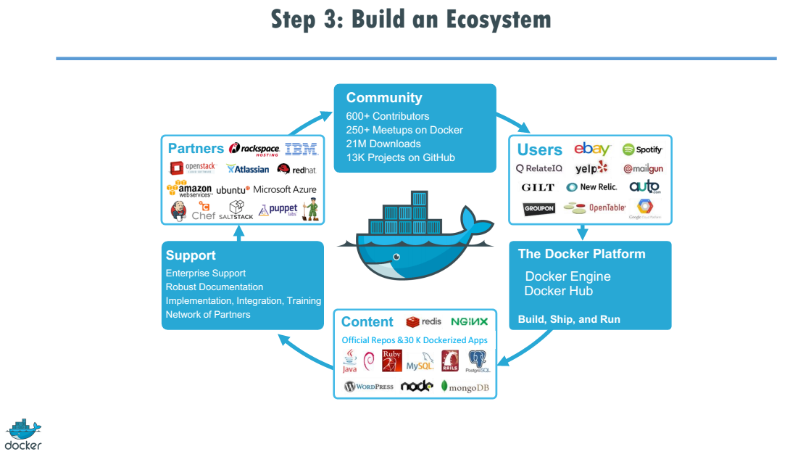

Slide 33
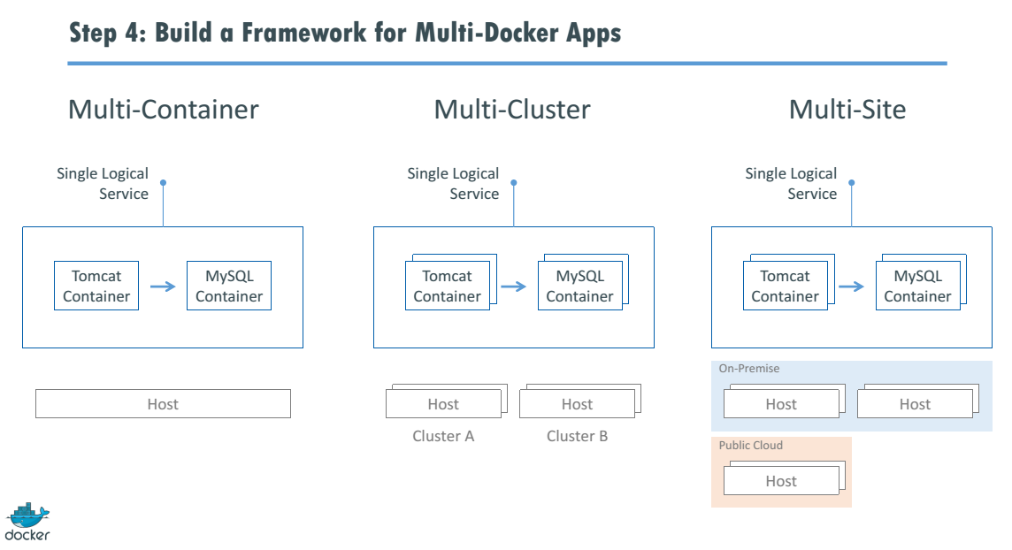

Slide 34
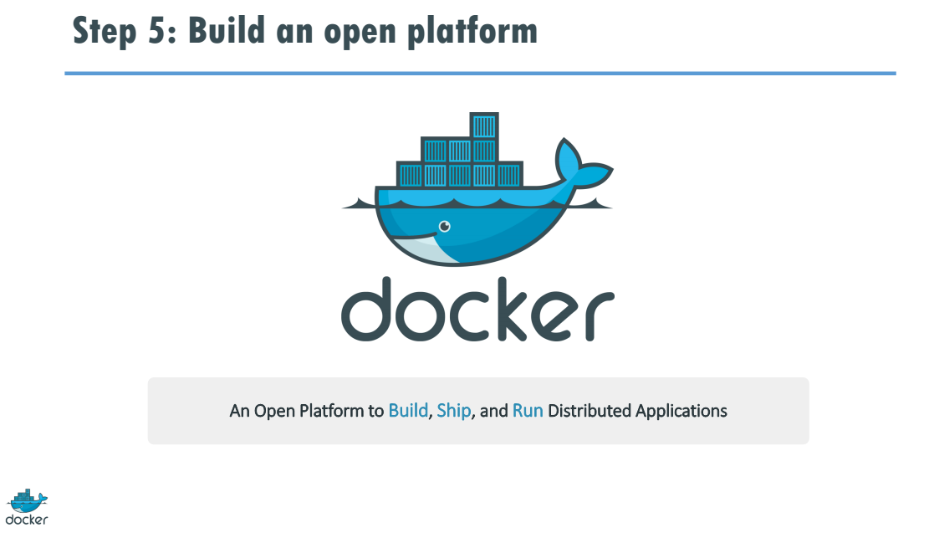

Slide 35
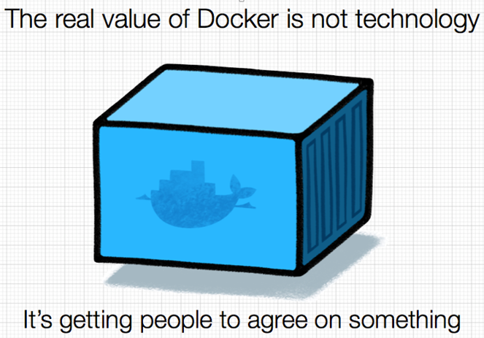

Slide 36
Behind the curtains . . .

Slide 37
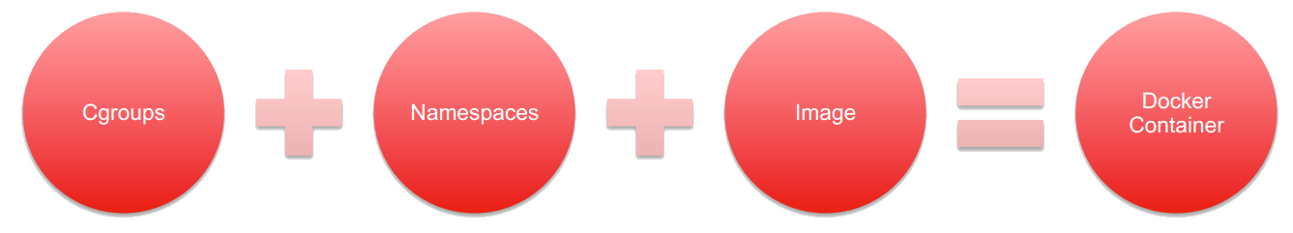
Docker containers
Linux Cgroups – control groups allocate resources
Kernel Namespaces – process isolation
Docker Image – a disk image that contains a series of layers

Slide 38
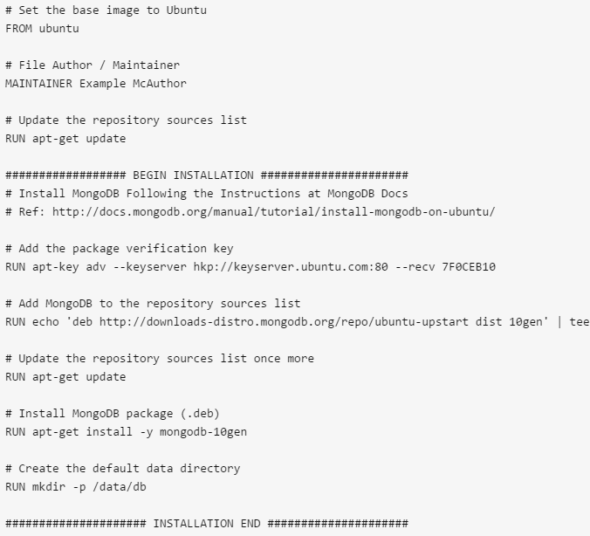
Dockerfiles
A series of instructions on how to build a container. It uses a base image and then runs the Dockerfile commands on it.

Slide 39
If we run the same Dockerfile we are running the same container with the same app!

Slide 40
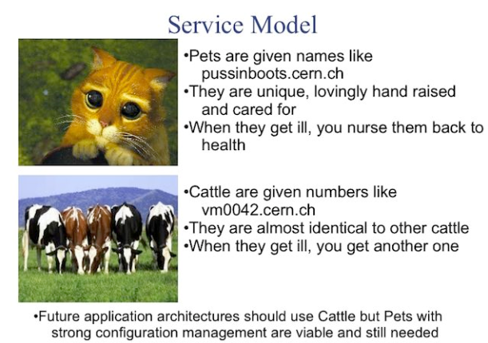
Docker vs VMs

Slide 41
Docker Weaknesses?

Slide 42
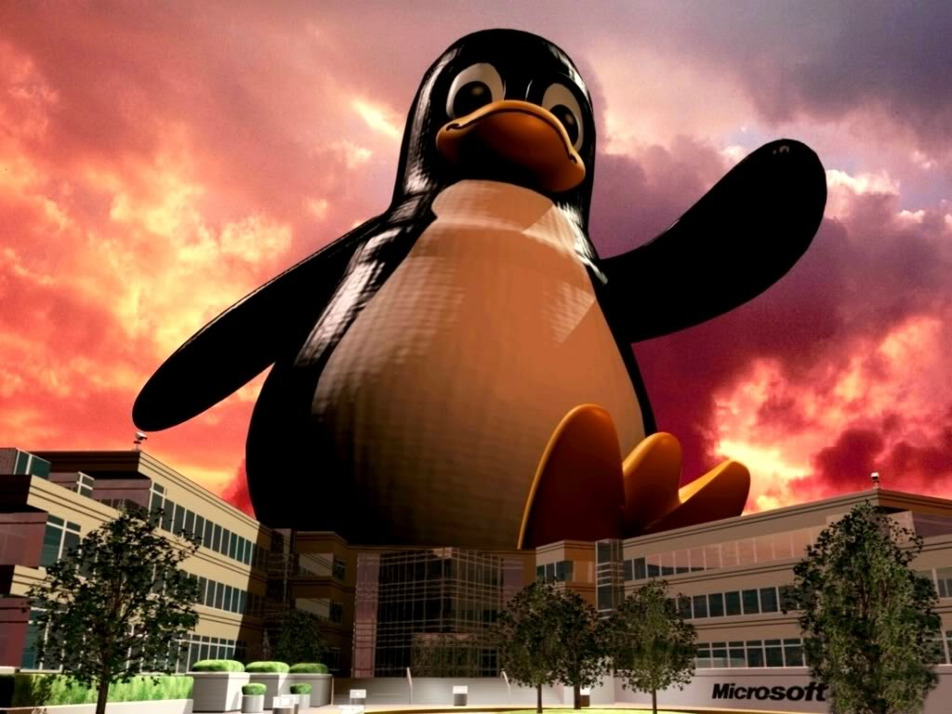

Docker weaknesses
Linux only . . . Redmond finally caught on. Tux still rules though ☺

Slide 43
Docker weaknesses
Security and network complexity
VMs are still easier to secure and to network in a way that lets the security folks sleep at night
A user with root access to a container can possibly have root access to the underlying OS filesystem if shared
Unlike a VM, kernel vulnerability for arbitrary code execution can put the entire Docker host at risk

Slide 44

Docker weaknesses
Interprocess communication between containers on different servers can be complex
Ambassadors

Slide 45

Docker weaknesses
Distributed system management is difficult across many hosts
Kubernetes
Mesos

Slide 46

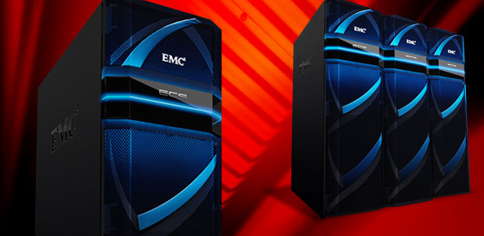
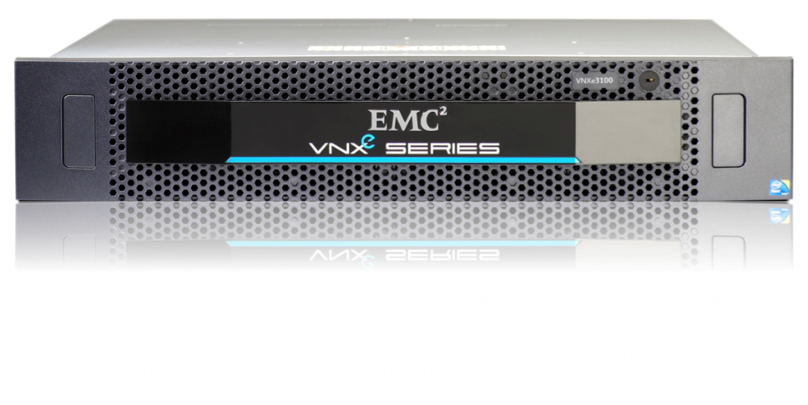
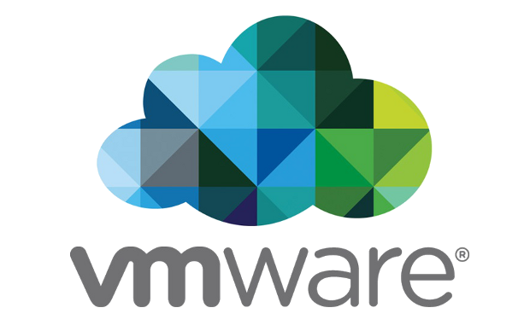
Docker @ EMC Federation
Diego Droplet Execution Engine
EMC Elastic Cloud Storage
VNXe C4 architecture
Automation Integration

Slide 47
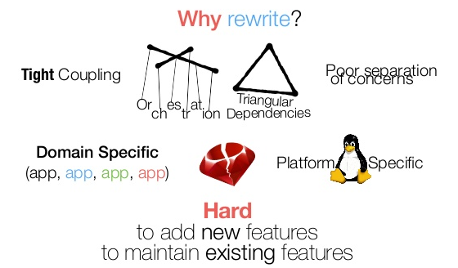
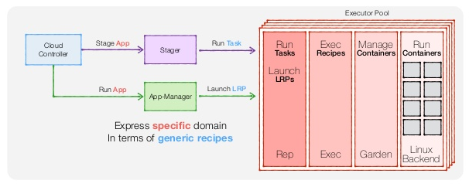
Diego Droplet Execution Engine
The container can be Docker, Warden, or whatever *
* Because of Warden’s tight integration into CF it does continue to have diagnostic abilities that Docker doesn’t possess at this point.

Slide 48
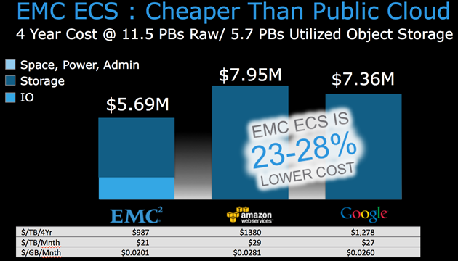
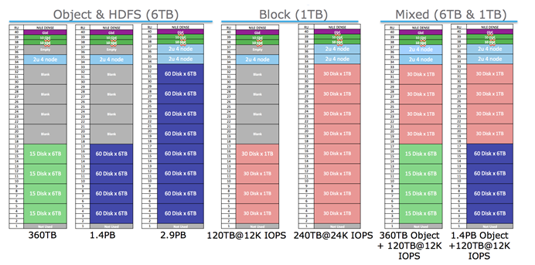
EMC Elastic Cloud Storage
Block, Object, and HDFS on commodity hardware managed by EMC ViPR, Apache ZooKeeper, and Docker

Slide 49
VNXe C4 architecture
Innovate rapidly
Maintain fanatical quality
Portability of new code between platforms
Hardware independence
Keep price low
Monolithic OS? – 5 noncompressable years
VM host? – performance concerns for RTOS
Containers are the answer – enter CSX!

Slide 50
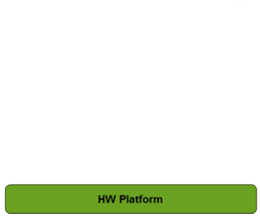





VNXe C4 architecture

Slide 51

Automation Integration
Delivering the best of both worlds:
Isolated and secure workloads via VMs (pets)
Lightweight apps via Docker (cattle)
PROJECT FARGO – VDI.next

Slide 52


Other Docker/Container projects @ EMC

Slide 53
Questions?

